Slide 1
Customer Lifetime Value Analysis:
A Business Presentation Outline Guide

Slide 2
Objective:
Given is the dataset of an Insurance company where our objective is to predict the Customer Lifetime Value. We are here to frame a regression model that gives us the prediction of the Customer Lifetime Value and can predict which of the customers are profitable from this insurance company.
Considering this objective, we are running a Linear Regression model on CLV , to analyze the influence of several independent factors that affect the target variable or Customer Lifetime Value.

Slide 3
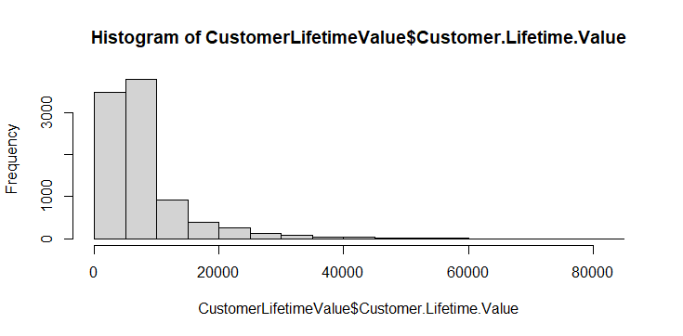
Dependent Variable:
Here in our data set Customer lifetime Value is the target variable. Customer Lifetime Value means the total revenue the client will derive from their entire relationship with a customer i.e. the total amount of money a customer is expected to spend in your business.

Slide 4
Count Of Variables And Observations:
After importing the data in our preferred software , we can conclude that:
There are 9134 observations with 22 variables as a whole. And this data does not contain any missing values.

Slide 5
Significant Variables:
The final significant columns after performing the correlation, anova test and multicollinearity test are:
Coverage (Extended & Premium)
Employment Status (Employed, Medical leave)
Type of open complaint(Type 3 & Type 4)
Type of policies (2-9)
Vehicle Class( Luxury SUV, Luxury Car, Sports Car, SUV)

Slide 6
Insignificant Variables:
The final insignificant variables are after performing different tests:
Total claim amount
Education
Employment Status(medical leave, unemployed, retired)
Marital Status
Type of open complaint( 1,2&5)
Renew offer
Vehicle class

Slide 7
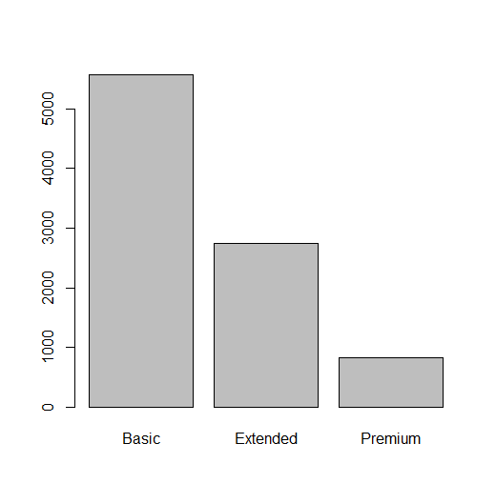
Explanation Of Significant Variables:
Coverage: the usefulness of this column is to show the customers the different types of coverage schemes provided by the company. This is a significant column because this helps the customers to take the decision of how much they expect to invest in that company i.e. whether they will get greater coverage or not if any damage happens.
This shows that basic coverage was offered for maximum person , then comes the extended one and and least people are offered for the premium
scheme.

Slide 8
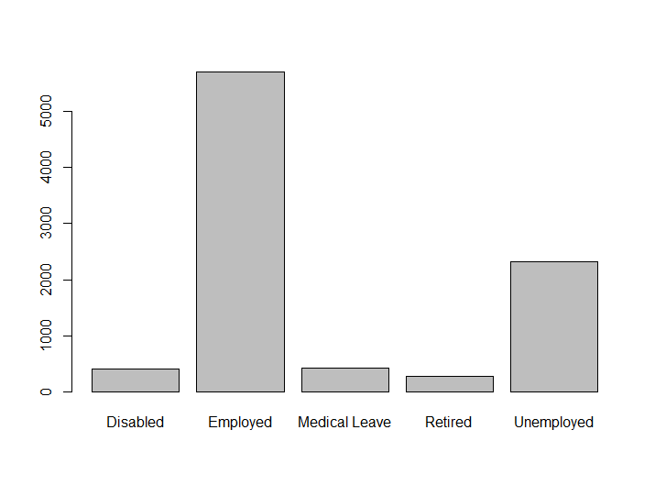
Employment Status: (Employed & Medical Leave)
This is an important column to take into consideration because those who are employed and those who are temporarily on a medical leave can only invest and for others it will be difficult to go for the scheme.
This gives us about the clear idea about the
employment status of the employed person
and those who are in medical leave.
By looking into this data, company will
approach to them who are employed and
temporarily in medical leave.

Slide 9
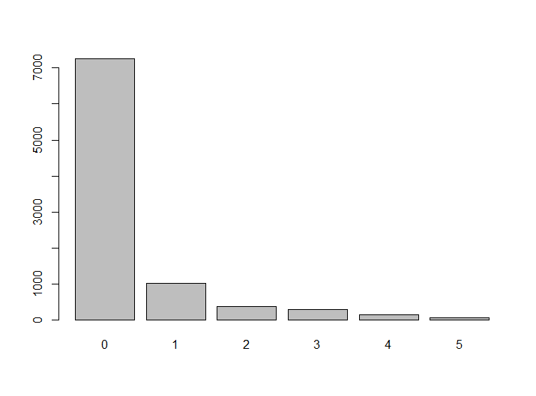
Type Of Complaint: (Type 3 & Type 4)
This column is basically the complains raised by the customers. Here type 3 and type 4 are the significant variables because may be the premium coverage customers fall into this category and that may affect the investment strategy of the customers.

Slide 10
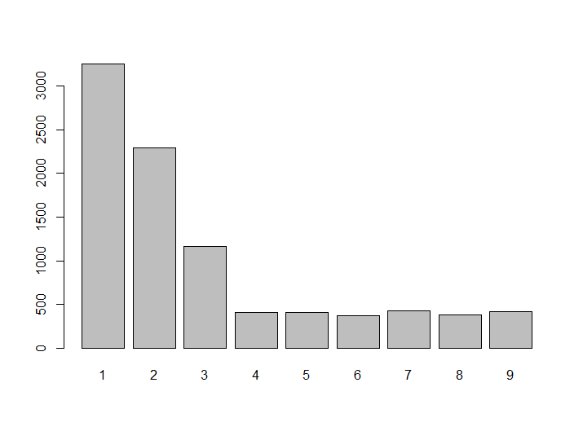
Types Of Policies (2-9)
This column says us the different types of policies offered by the company so that by having a proper knowledge of the polies customers can invest for different schemes/policies.

Slide 11
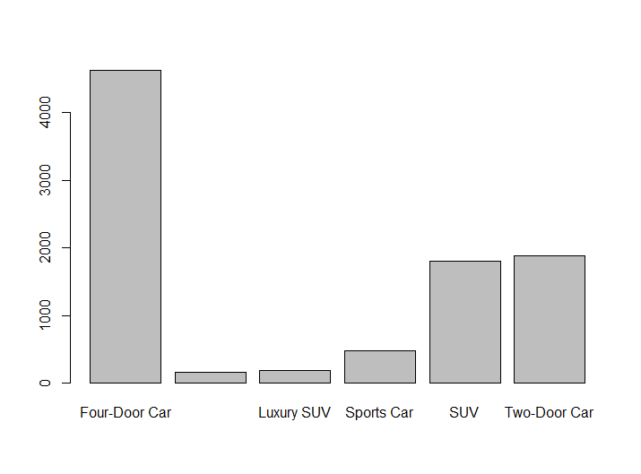
Vehicle Class(Luxury Car, Luxury SUV, SUV, Sports Car):
Different class of vehicles for which auto insurance are provided by the company. This helps the customers to know the category under which there car falls into.

Slide 12
Results Found :
Here in our script we performed different tests and we found there results. Now the results may vary from person to person because every time we run the model, it takes different sets of values and provide us with different results.
Correlation test- In the beginning we performed the correlation test, which implies whether the predictor(continuous) do have any correlation with the target variable (continuous) or not and for that we have to set the threshold level. We know correlation lies between -1 to 1 and by looking into the data we set out threshold level to 0.2 where only monthly premium auto and total claim amount column satisfied the level. So from this we can conclude that with our target variable this two column do have some relation.
Anova test- Next we performed this test which gives us the relationship between target variable(continuous) and predictor(categorical). Here the null hypothesis implies that the variables are not correlated. So here we got, coverage, education,employment status, marital status, type of open complaint, type of polies, renewal offer type, vehicle class, vehicle size are the columns that reject the null hypothesis and are having some relation with the target variable.

Slide 13
Multicollinearity test- This implies one variable have correlation with other variables
So if the variable lies below 1 then it has no multicollinearity, if it lies between 1- 5 then it is having moderate multicollinearity and if it is more that 5 then high multicollinearity is present. And here monthly premium auto is having multicollinearity, so removed that column from the model.
Next we fitted the linear regression model, and we got the value of r-square as 0.6191 and adjusted r-square as 0.6169.
Next we performed, Anderson Darling test which helps us to check whether the errors are normally distributed or not. And here we see, that it is rejecting the null hypothesis i.e. below 0.05. Therefore errors are not normally distributed.
Durbin-Watson Test helps us to check whether there is any autocorrelation or not. Autocorrelation implies whether the residuals are not independent from each other. Here we can see that we accept the null hypothesis i.e. there is no autocorrelation.
Breusch-Pegan Test helps us to check whether the error variance are equal or not. After performing the test we conclude that we reject the null hypothesis and can say that error variance are not equal i.e. p-value is below 0.05.

Slide 14
Absolute Percentage Error Calculation:
Here we calculated it in two ways, one with the help of mean and another with the help of median.
So from our predicted model we can conclude that the mean absolute error percentage is 73.33 and the median absolute error percentage is 81.95.
Mean is always smaller than the median because of the present of outliers.

Slide 15
Visual Relationship:
Positive Variable implies if the predictor/independent variable rises by 1 unit, target/dependent variable will increase by its corresponding estimate values.
Similarly, for negative variable if the predictor/independent variable decreases by 1 unit, target/dependent variable will decrease by its corresponding estimate value.
Positive Variables: Total Claim Amount, Coverage(all Levels), Education(doctors, High School, Masters), Employment Status(all), Type Of Open Complaint(level 1), Type Of Policies (All Type), Renewal Offer Type(all), Vehicle Class(all Type), Vehicle Size(all Type).
Negative Variables: Education(college), Marital Status( All Type), Type Of Open Complaints (2-5).

Slide 16
Business Recommendation:
So hereby looking into different significant and insignificant columns, positive and negative variables , we can convey to our clients about some important points by which they can be profitable.
So first of all let us talk about the coverage. Here coverage is an positive variable. So my clients can invest according to it. If they want to get a huge amount of coverage for their vehicle, then they have to invest more and vice versa.
Similarly goes with the total claim amount, if they expect that they will get the total amount they claimed then they have to invest more. In other words, more claim amount more investment and vice-versa.
Let us consider the types of policies. Now different policies contain different advantage to the clients and the policies are designed in such a manner that it is customer friendly. So different policies are beneficial for our clients and it is advantageous to them.
Renewal offer type is again beneficial for the clients because vehicles are assets to them and it is obvious that maintenance of the assets are required which is the cost for on client. So if they renew there offers they will be minimizing there cost.

Slide 17
Now the type of open complaints will give a negative impact to the clients. Because if a client go for a history and have a look into the complain list they may get a negative impact.
Employment Status can provide a positive impact to the clients because they can afford for the premiums and all.

Slide 18
Thank You

